Slide 1
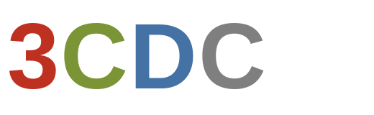
Building the IT Foundation for Data Driven Marketing
Mike
Goulet
A Presentation to 3CDC Leadership
3
C
D
C
Cincinnati, Ohio | 2026

Slide 2

About My Technical Experience
16
100+
5
Websites and Apps
Launched
IT Documents
Authored
Platform Migrations
Led
Proven track record managing digital systems with 50+ users
Deep experience bridging technology with marketing and operations
Passionate about using technology to create exceptional customer and business user experiences
Cincinnati community advocate — here to stay, ready to help

Slide 3



Vision as IT Director
Reliable
Foundation
Connected
Systems
Empowered
Team
Own current infrastructure and future state planning
Become subject matter expert in critical software, hardware, and field-based platforms
Documentation: MSP documentation, user guides, configuration logic, continuity planning, dependency mapping
Implement centralized data strategy with scalability (data lake)
Automate dataflows with connected applications
Enable data-driven customer experience enhancements
Self-service IT resources & knowledge base
Access, role, and permission management
Clear escalation paths and mitigation procedures
Onboarding and documentation for new hires

Slide 4





Approach: Understand, Assess, Action
Technology Audit
Stakeholder Alignment
Vendor Review
Assess current state of all hardware, software, licensing, and security across 3CDC's portfolio.
Meet with every department head to understand pain points and align IT priorities with org goals.
Review tech related services for value, bloat, usage, and renewal dates. Assess options to optimize spend going forward.
Data Strategy
Digital Brand Audit
Quick Wins
Map existing data sources and define data storage options for leadership decision-making. Determine data continuity requirements. Implement centralized storage.
Evaluate website, search, and conversion performance. Identify issues and opportunities, create action plan to address based on value and effort.
Identify and deliver 2–4 high-visibility improvements in the first 90 days to build trust.

Slide 5
Growing into Marketing Technology
Level 1
Level 2
Level 3
IT Director
IT + Data
IT + MarTech
Identify current uses and shortcomings of IT stack
Centralize data storage and access
Security and compliance framework
Subject matter expertise in critical systems
Enable data-driven decision making across org
Partner with departments and BI to create self-service dashboards
Define customer segments and value assessments (parking)
Leverage Cincinnati business network for analytics expertise*
Market and product analysis: assess product mix for new product opportunities
Implement cross-marketing assets and campaigns for programming
Test segment and event specific targeting and messaging

Slide 6
Impact: IT Efficiency and Revenue Growth
IT Spend Efficiency
Revenue Growth
Visibility:
Comprehensive view of all current IT spend and 3rd party contracts
Insight into technical and cost efficiency opportunities
Accountability:
Central ownership of system and vendor management with a focus on efficient spend and scalability
Inhouse project management lead for internal initiatives and IT planning
Data Utilization:
Implement centralized data lake for all proprietary and third-party data, identify functional areas for data-marts or similar
Build internal dashboards to provide org decision makers with real time data and insights
Product Development:
Identify key product gaps in customer experience
Work with internal experts and market research to identify opportunities for new products; research, develop, test, and launch

Slide 7
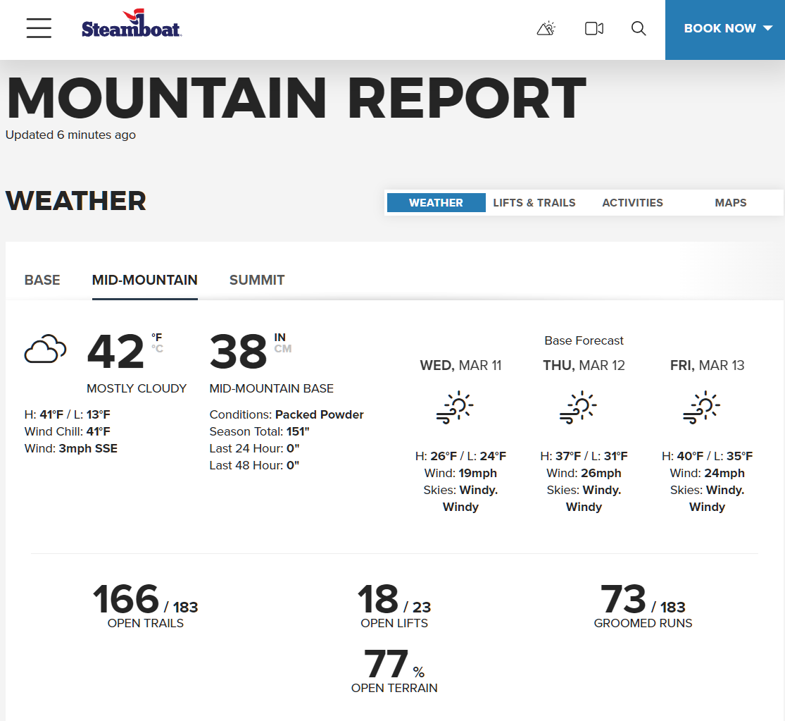
My Past Work: Mountain Report Status Page
What: built white-label templates for weather and conditions reporting on group of 14 ski resorts (#1 viewed webpage in winter on all sites)
Why: single point of communication for potential customers, standardized and enhanced experience across resort sites, reduced development costs
How: developed module based frontend, flexible backend to accommodate 20+ data sources, and partnered with vendor to create custom data feeds
3CDC Relevance: multi-source reporting, use case of combining technical development with marketing value, customer-facing status information

Slide 8
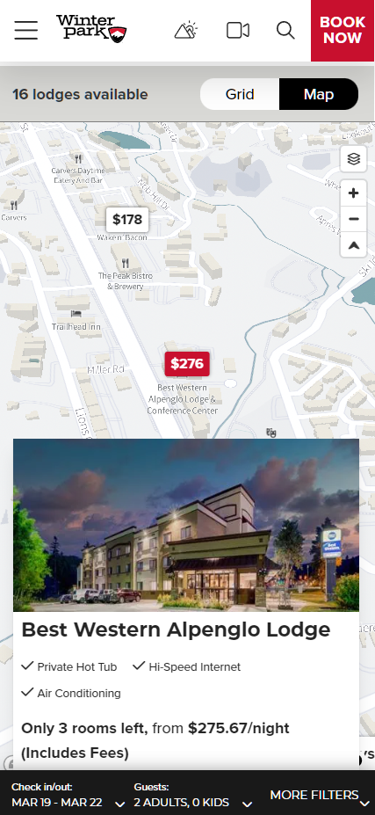
My Past Work: Lodging Availability Map View
What: developed map to display lodging locations, real-time availability and pricing, and filterable search
Why: enhanced customer experience, enables location-sensitive customers to select best lodging booking for their needs
How: developed location display system, frontend map features, integrated lodging eCommerce platform with CMS (API based)
3CDC Relevance: real-time availability and pricing for location-sensitive customers, takes advantage of 3CDC parking network, enables customers to select best 3CDC parking for needs leading to increased satisfaction

Slide 9
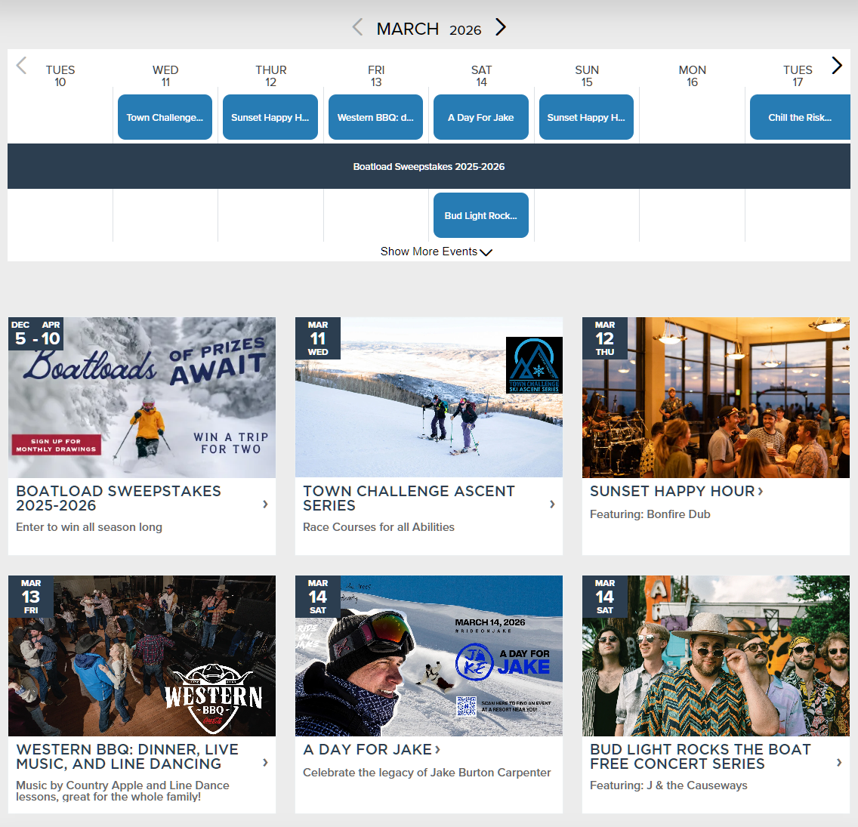
My Past Work: Event Calendar
What: developed interface to display upcoming events to customers
Why: standard event features could not display amount or duration of events in an intuitive way for customer planning
How: developed weekly timeline view feature, detail tiles and pages, call to action with functionality for ticket sales or event registration
3CDC Relevance: intuitive event calendar enables customers to search by specific event or date, detail page enables cross-sell for nearby 3CDC parking

Slide 10
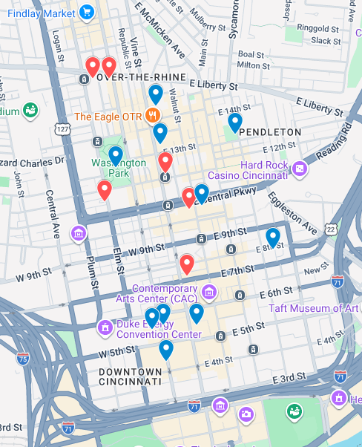
Quick Win: 3CDC Parking Homepage Map View
What: parking map view displaying each 3CDC parking property (Phase 1)
Why: capitalizes on 3CDC network of parking properties and SEO while enhancing customer experience (3 clicks from search to navigation)
How: develop map view feature and implement on homepage above fold, implement SEO best practices
3CDC Relevance: drives traffic from search engines into conversion funnel, increases awareness of all 3CDC parking options
Phase 2: in-map tile (selected location) displaying images of property and attributes (covered, monitored 24/7)
Phase 3: real-time parking garage availability, parking lot open/full status

Slide 11

Why Me. Why 3CDC.
Why Me
Why 3CDC
Proven experience executing technology projects for complex, multi-property environments
3CDC's mission to revitalize Cincinnati's urban core aligns with my personal values
Track record bridging IT strategy with marketing and revenue goals
OTR and Downtown are a turnaround story — technology can build on 3CDC’s brand and momentum
Hands-on expertise in managing software, hardware, digital platforms, and analytics
A non-profit environment where technology and marketing enhance community impact
A strategic thinker who also rolls up their sleeves and executes
Opportunity to contribute meaningful work for neighbors
Deep commitment to Cincinnati — this is my city and I want to invest my efforts in its success
A respected, collaborative team with a strong culture, clear vision, and real results

Slide 12
Let’s make downtown the
destination for Cincinnati.
Mike Goulet | gouletco@gmail.com | (701) 471-8712 | Cincinnati, OH
Thank You — Questions Welcome

